Slide 1
MACHINE LEARNING GRADUATION PROJECT
Smart Bank AI
An Intelligent Banking Platform
01
02
03
04
Loan Approval
Fraud Detection
Currency Prediction
Customer Segmentation
Team Members
1) Ziad Ahmed El Shamy 2) Youssef Mohamed 3) Mourad Moussa 4) Zahraa Reda

Slide 2
OVERVIEW
Agenda
01
The Problem
08
Customer Segmentation
02
Goals & Objectives
09
Model Portfolio
03
System Architecture
10
Design Principles
04
Datasets
11
User Portal
05
Loan Approval
12
Manager Portal
06
Fraud Detection
13
Challenges
07
Currency Prediction
14
Conclusion
SMART BANK AI
2

Slide 3
MOTIVATION
The Problem
Banks handle four recurring challenges manually or with disconnected legacy tools. Smart Bank AI solves all four with a single integrated platform.
L
Loan Decisions
F
Rare Fraud
Deciding whether to approve a loan consistently and fairly, across thousands of applicants.
Catching fraudulent transactions in near real-time, despite fraud being under 1% of transactions.
C
Currency Moves
S
Customer Insight
Helping customers and the bank anticipate currency movements for cross-border transactions.
Understanding which customers need which products without manually segmenting a large base.
SMART BANK AI
3

Slide 4
HOW IT FITS TOGETHER
System Architecture & Workflow
Data Layer
Four independent datasets — loans, transactions, exchange rates, customer records
▾
ML Layer
Four trained models, each saved as one deployable pipeline bundling preprocessing + model
▾
Backend Layer
One API (Flask) with a model registry loading all pipelines at startup; JWT auth for user vs manager roles; one endpoint per model
▾
Frontend Layer
Two portals — User Portal and Manager Portal — consuming the same backend with different permissions
SMART BANK AI
5

Slide 5
LET’S TAKE A GLANCE ON OUR PLATFORM!

Slide 6
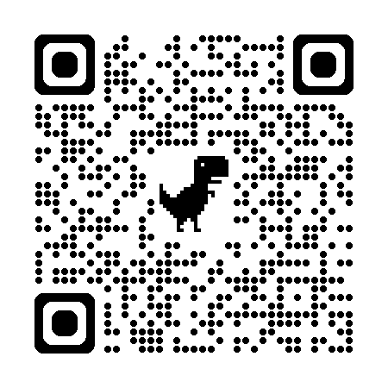
SCAN THE QR

Slide 7
FOUNDATION
The Four Datasets
Project | Dataset | Size | Key Features
Loan Approval | Loan approval classification dataset | 45,000 applicants 14 columns | Age, income, employment experience, loan amount/intent/interest rate, loan-to-income ratio, credit score, prior default history
Fraud Detection | Simulated credit card transactions (Sparkov-style) | ~1.3M train ~556K test | Transaction amount, merchant, category, cardholder demographics, timestamp, location
Currency Prediction | Live EUR/USD daily rates (Frankfurter API) | 680 days Jan 2024 – Aug 2026 | Historical daily rate, engineered lag and moving-average features
Customer Segmentation | Bank customer records (churn-style dataset) | 10,000 customers | Credit score, age, tenure, balance, number of products, geography, gender, estimated salary
SMART BANK AI
6

Slide 8
LET’S DIVE INTO OUR NOTEBOOKS!

Slide 9
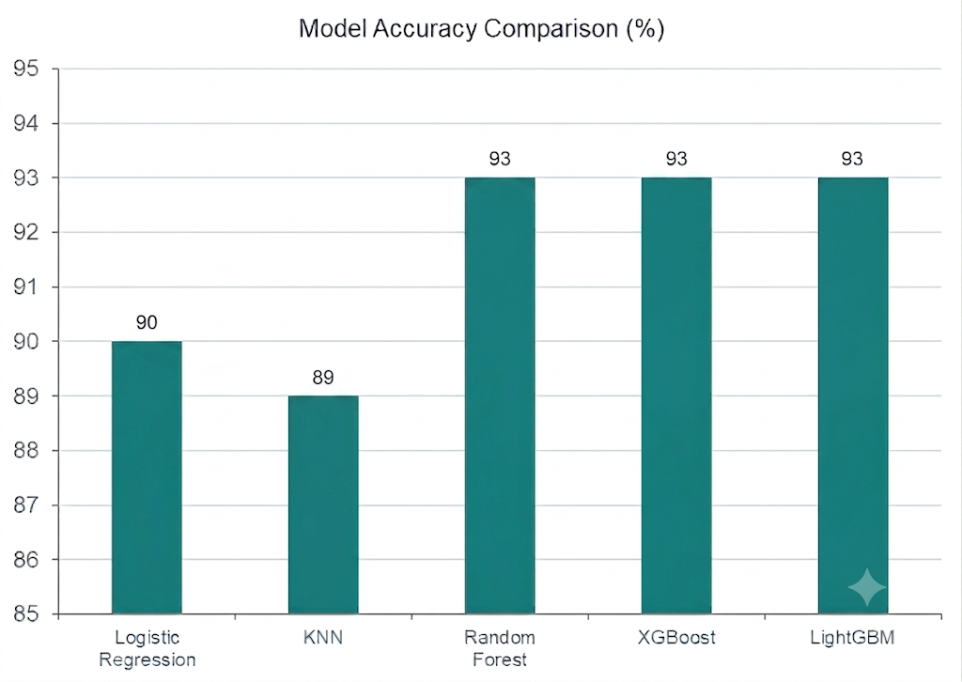
PROJECT 1 · SUPERVISED — CLASSIFICATION
Loan Approval
Goal: predict whether a loan application should be approved
Target is imbalanced (~78% rejected / ~22% approved) — accuracy alone is misleading
Prior default history, high loan-to-income ratio, and interest rate are the strongest drivers
Final model: tuned XGBoost, explained per-prediction with SHAP
Deployed as a single pipeline file (loan_model.pkl)
SMART BANK AI
7

Slide 10
PROJECT 2 · SUPERVISED — IMBALANCED CLASSIFICATION
Fraud Detection
Fraud is only ~0.58% of transactions — accuracy is meaningless; evaluation uses Precision, Recall, PR-AUC
Fraud amounts are far larger (median ~$396 vs ~$47) and spike 20–25x late at night (10pm–3am)
Final model: XGBoost with target encoding + class-imbalance handling, threshold tuned to 0.95
0.89
0.91
0.90
0.96
Precision
Recall
F1 (fraud class)
PR-AUC
SMART BANK AI
8

Slide 11
PROJECT 3 · SUPERVISED — REGRESSION / TIME-SERIES
Currency Prediction
Goal: predict the next day's EUR/USD exchange rate from ~2.5 years of live daily history
Features: lag values (previous day, previous week) and 7-day / 30-day moving averages
The simplest model — Linear Regression — won: exchange rates behave close to a random walk day-to-day, a legitimate, defensible finding
Deployed as a lightweight pipeline returning tomorrow's predicted rate
SMART BANK AI
9

Slide 12
PROJECT 4 · UNSUPERVISED — CLUSTERING
Customer Segmentation
Goal: group bank customers into behaviorally meaningful segments — no labels used
Features: credit score, age, tenure, balance, products, salary, plus geography & gender (one-hot)
Method: K-Means, sweeping k = 2 through 10 and selecting the value that maximizes silhouette score
Visualized in 2D with both PCA and t-SNE projections; pipeline saved for live segment assignment
RESULT
Best silhouette score achieved at k = 2
High
Balance
Low
Balance
Two clearly distinguishable segments, differentiated primarily by account balance level.
SMART BANK AI
10

Slide 13
SUMMARY
Model Portfolio
Project | Learning Type | Algorithms Compared | Final Model | Headline Metric
Loan Approval | Supervised (classification) | Logistic Regression, KNN, Random Forest, XGBoost, LightGBM | XGBoost (tuned) | 93.1% accuracy 0.978 ROC-AUC
Fraud Detection | Supervised (imbalanced) | Logistic Regression, Decision Tree, Random Forest, XGBoost | XGBoost (tuned threshold) | 0.90 F1 (fraud) ~0.96 PR-AUC
Currency Prediction | Supervised (regression) | Linear Regression, Random Forest, XGBoost | Linear Regression | MAE 0.003 (EUR/USD)
Customer Segmentation | Unsupervised (clustering) | K-Means (k = 2 to 10 tested) | K-Means, k = 2 | Silhouette- optimized
Both supervised and unsupervised learning are represented, and every final model was chosen by empirically comparing multiple algorithms — not by assumption.
SMART BANK AI
11

Slide 14
WHAT UNIFIES THE SYSTEM
Design Principles
1
Same Workflow Every Time
2
Self-Contained Pipelines
Load & Understand → Clean → EDA with explicit insight statements → Feature Engineering → Preprocessing → Compare algorithms → Justify the choice → Save as one deployable artifact
Every final model bundles preprocessing and the trained model into one saved file, so the backend calls one uniform .predict() regardless of which model it's talking to
3
Metric Discipline
4
Consistency Over Cleverness
Accuracy fits the roughly-balanced loan data; precision/recall/PR-AUC were required for imbalanced fraud; MAE/RMSE for regression; silhouette score for unlabeled clustering
Every project benchmarks multiple candidate algorithms before selecting a winner — including cases, like currency prediction, where the simplest model won
SMART BANK AI
12

Slide 15
CUSTOMER-FACING
User Portal
Sign Up / Log In
Apply for a Loan
1
2
Secure account access for every customer
Submit an application and instantly see the prediction
Transaction Alerts
Currency Tools
3
4
View personal transaction and fraud alerts
Use the currency converter and predictor
My Segment
Personal Dashboard
5
6
See which customer segment they've been placed in
A summary of their financial activity
SMART BANK AI
13

Slide 16
ADMIN-FACING
Manager Portal
Live Model Dashboard
Fraud Review Queue
1
2
Performance metrics for all four models
Review transactions flagged as suspicious
Loan Review Queue
Segmentation Viewer
3
4
Review pending loan applications
Interactive cluster plot plus segment profiles
Usage Analytics
5
Overall platform usage analytics
SMART BANK AI
14

Slide 17
LESSONS LEARNED
Challenges
!
Handling the severe class imbalance in the fraud dataset (0.58% fraud) required careful metric selection and decision-threshold tuning rather than default settings
!
Integrating four independently-built notebooks, each with its own preprocessing conventions, into one consistently-servable backend format
!
Currency movements are close to a random walk day-to-day, which caps how much predictive lift any model can realistically add
!
Clustering has no ground-truth "correct" answer, so the number of segments had to be justified with silhouette score rather than intuition alone
SMART BANK AI
15

Slide 18
WRAPPING UP
Conclusion & Future Work
Smart Bank AI successfully unifies four independent ML components — two classification models, one regression/forecasting model, and one clustering model — behind a single platform with tailored user and manager experiences, demonstrating both supervised and unsupervised learning end-to-end, from raw data to a deployable pipeline.
FUTURE WORK
Real-time model monitoring and retraining
Expanding currency prediction to more currency pairs
Refining customer segmentation with richer behavioral data
Adding explainability (SHAP) to more of the models
Thank You
SMART BANK AI
16

